Slide 1




Elicitation of Willingness to Pay for Upgradeable Products with Calibrated Auction-Conjoint Method
V. Lobasenko
D. Llerena

Slide 2
Introduction
New product development originates from new technologies or from new market possibilities (Eliashberg et al., 1995).
Innovation is a means to compete while satisfying consumers’ constantly changing preferences.
A new product (including improvements, line extensions and upgrades) may be interpreted as a product, which avoids an obsolescence of the product itself.
Nidumolu, Prahalad and Rangasami (2009) claim that “[S]mart companies now treat sustainability as innovation’s new frontier.”

Slide 3
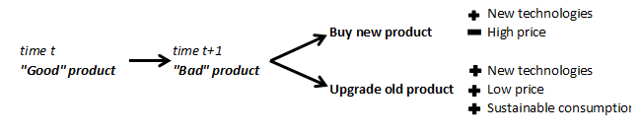
Concept of upgradeable products Literature review
A fundamental research on upgradeable products by Alptekinoglu and Ramachandran (2014) consists of claiming that consumer may adjust some attributes of the product while using/consuming it.
Ülkü et al. (2012) state that the valorization of an upgradeable product depends on
initial price
price of upgrade
periods between upgrades
perceived quality of the upgrade
perceived efforts to install it
The results show that in general consumers are willing to pay premiums for upgradeable products, however, the more distant the upgrade is, the smaller are the premiums. The authors also conclude that consumers are willing to pay less if the perceived quality of an upgrade is low and the perceived efforts are high.
Notes:
If consumers’ preferences change in time, a consumer may have a disutility from having a ‘bad’ product at time t+1, when he/she has bought this product at time t while it was ‘good’ yet.
Ülkü et al. (2012) The authors use a titration method and state that the valorization of an upgradeable product depends on the initial price and the price of upgrade, the periods between upgrades, the perceived quality of the upgrade and perceived efforts to install it.

Slide 4
Concept of upgradeable products Literature review (contd)
Michaud et al. (2015)
utility from buying an upgradeable product is larger than the utility from not buying it
the option to improve energy efficiency in the future creates more utility than the option to upgrade product performance
a longer length of time between two upgrades increases the purchase probability
when upgrades have to be made by the user (versus a specialist), the probability of purchasing a product is decreased
Notes:
The discrete choice experiment permits us to make the conclusion that the utility from buying an upgradeable product is larger than the utility from not buying it, however, it exists a large heterogeneity of individual preferences for different products and for the upgrade attributes. The option to improve energy efficiency in the future creates more utility than the option to upgrade product performance. In addition, a longer length of time between two upgrades increases the purchase probability. This result can be linked to the perception that consumers have about future technologic developments of products. We also notice that when upgrades have to be made by the user (versus a specialist), the probability of purchasing a product is decreased.

Slide 5
Method
Calibrated Auction-Conjoint Method (CACM) (Lusk and Norwood, 2011).
combines benefits of a conjoint analysis, such as simplicity for respondents (Adamovicz et al., 1998, Voelckner, 2006) and revealing demand separately for each alternative, with those of auctions, as a less biased measure of WTP, possibility to answer more thoughtfully placing their bids for a product
allows assessing the components of preferences and WTP for the product’s upgrades
allows evaluating a large number of attributes with many levels and for numerous products, decomposing preferences by this.
The method consists of three stages (Lusk and Norwood, 2011; Kovalsky and Lusk, 2013).

Slide 6
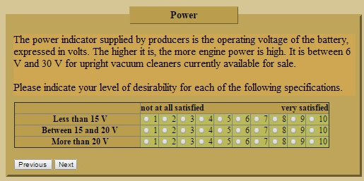
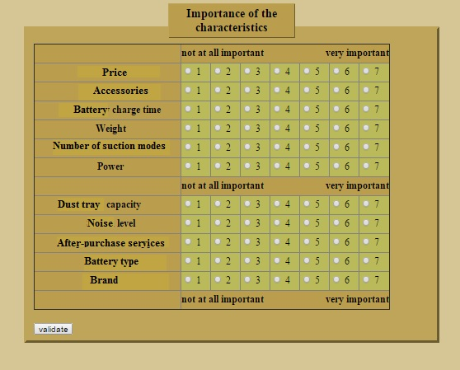
Method
First stage proposes a participant to rate the desirability of each attribute level of the product on the Likert scale
(1 is the least desirable and 10 is the most desirable), assuming that all other characteristics are hold constant.
On the second stage respondents are invited to indicate the relative importance of each attribute of the product on the Likert scale of 1 to 7
(1 is very unimportant and 7 is very important).

Slide 7
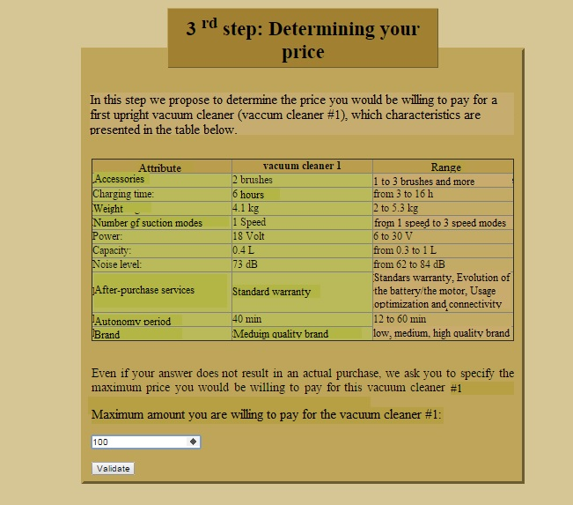
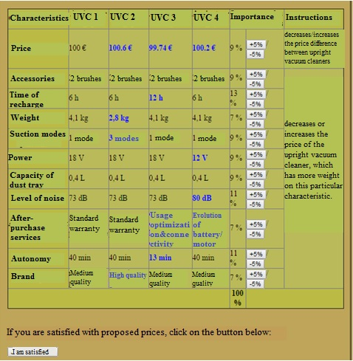
Method
On the third stage participants see the summary of their bids for several configurations of the product, which are calculated on the basis of the answers on previous stages.
If they do not agree with WTP calculation, participants are invited to “calibrate” their answers on previous stages by changing weights, and get new WTP.

Slide 8
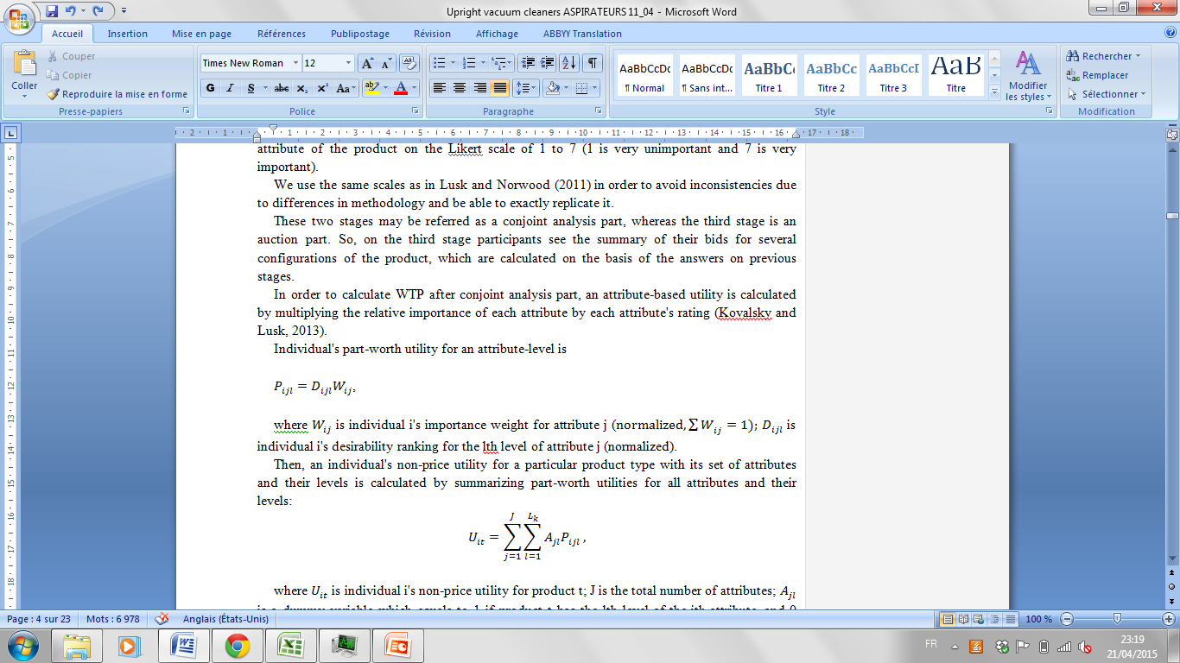
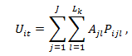
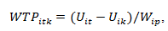
WTP calculation
In order to calculate WTP after conjoint analysis part, an attribute-based utility is calculated by multiplying the relative importance of each attribute by each attribute's rating (Kovalsky and Lusk, 2013).
Individual's part-worth utility for an attribute-level is
Where W_{ij} is individual i's importance weight for attribute j
D_{ijl} is individual i's desirability ranking for the lth level of attribute j (normalized).
Then, an individual's non-price utility for a particular product type with its set of attributes and their levels is calculated by summarizing part-worth utilities for all attributes and their levels:
Where U_{it} is individual i's non-price utility for product t;
J is the total number of attributes;
A_{jl} is a dummy variable which equals to 1 if product t has the lth level of the jth attribute, and 0 otherwise.
Final step of WTP calculation is based on estimation of difference in WTP for one product over another, in other words a premium:
Where WTP_{itk} is individual i's WTP premium for product t over product k;
U_{it(ik)} is individual i's utility for product t(k);
W_{ip} is individual i's importance weight for price attribute.

Slide 9
Experimental design. General Information
The concept of upgradeable products has been implied for two types of vacuum cleaners:
an upright wireless vacuum cleaner
a wired vacuum cleaner
Upgrade attribute – After-purchase services:
Usage optimization and connectivity upgrade
functional upgrade (a change of an important part of a vacuum cleaner, such as a motor or a battery)

Slide 10
Attributes and their levels
Attribute | Levels
 | Upright vacuum cleaner | Wacuum cleaner
Brand | Low quality brand | Low quality brand
 | Meduim quality brand | Meduim quality brand
 | High quality brand | High quality brand
Power max | Less than 10 Volts | Less than 1600 W
 | 10-20 Volts | 1600-2000 W
 | More than 20 Volts | More than 2000 W
Capacity of the dust tray | Less than or equal to 0,5 L | Less than or equal to 2,5 L
 | 0,5- 1 L | More than 2,5l
Price | Less than 100 Euros | Less than 100 Euros
 | 100-150 Euros | 100-150 Euros
 | 150-200 Euros | 150-200 Euros
 | 200-250 Euros | 200-250 Euros
 | 250-300 Euros | 250-300 Euros
 | More than 300 Euros | More than 300 Euros
Number of suction modes | 1 mode | 1 mode
 | 2 modes | 2 modes
 | 3 modes or more | 3 modes or more
Accessories | One brush | One brush
 | Two brushes | Two brushes
 | More than two brushes | More than two brushes
Attribute | Levels
Noise level | Less than 71Db | Less than 71Db
 | 71-75 Db | 71-75 Db
 | 75-79 DB | 75-79 DB
 | More than 79 Db | More than 79 Db
After-sales service (Upgrade) | Standard warranty | Standard warranty
 | Usage optimization and connectivity | Usage optimization and connectivity
 | Evolution of the battery/the motor | Evolution of the battery/the motor
Energy consumption |  | Less than 160 kWh/year
 |  | 160-200 kWh/year
 |  | More than 200 kWh/year
Length of the cable |  | Less than 5 m
 |  | 5-7,5 meters
 |  | 7,5-10 meters
 |  | More than 10 meters
Presence of a dust bag |  | yes
 |  | no
Autonomy time | Less than 20 min
 | 20-40 min
 | More than 40 min
Duration of recharge time | Less than 5 hours
 | 5-10 hours
 | More than 10 hours
Battery | Ni-mh
 | Lithium
Weight | Less than 3 kg | Less than5 kg
 | 3-4 kg | 5-6 kg
 | More than 4 kg | More than 6 kg

Slide 11
Experiment
Online survey in May 2014
Total 323 participants (224 participants for a wired vacuum cleaner and 98 participants for an upright wireless vacuum cleaner)
Reward a participation: a lottery for a "coupon" with 50€ value (1 coupon for 300 participants)
For upright vacuum claner owners – proposed a questionnaire on upright vacuum cleaner
For wired vacuum cleaner owners – proposed a questionnaire on wired vacuum cleaner
For those who have both or none – a choice is proposed
At the end of the first questionnaire a participant is proposed to answer the other one
A socio-demographical questionnaire

Slide 12
After- purchase services attribute
Option “standard warranty” is an option that provides a phone and / or online support allowing the customer to get personalized assistance on the functioning of the upright vacuum cleaner, as well as a standard exchange service at home with the manufacturer's warranty.
Option “usage optimization and connectivity" is based on a system of sensors that tell you about your "performance" when vacuuming (duration of use, sucked dust levels, the degree of dirt ...). The "connection" function is to control various connected devices at your home from the upright vacuum cleaner (lights, shutters ...).
Option "evolution of the battery/the motor" is based on upgrades at regular intervals of the engine and the battery of the cleaner. These upgrades are available depending on technological developments. For an upgrade of the upright vacuum cleaner, it will be necessary to replace the old engine and / or battery by its improved version.

Slide 13
Results. Upright Vacuum Cleaner

Slide 14
After-purchase services
 | Standard warranty | Usage optimization and connectivity | Evolution of the battery/the motor
Mean | 0,678 | 0,311 | 0,459
Women | 0,694 | 0,331 | 0,422
Men | 0,647 | 0,259 | 0,552
Notes:
For an upright vacuum cleaner participants indicate standard warranty as important level of after-purchase services attribute, ranking 0,68 on average, only 0,31 for the usage optimization and connectivity and 0,46 for the evolution of the battery /the motor (Table 3.). However, there is a significant difference between men and women ratings for upgrade functions: men largely prefer (0.13 more) the evolution of the battery or the motor than women, when women (0.07 more) prefer the usage optimization and connectivity.

Slide 15
Weights distribution. Upright vacuum cleaner
Notes:
The distribution of weights shows that most of the attributes have equal weight for the consumers. The three less valued attributes for an upright vacuum cleaner are the brand, the accessories and the warranty services.

Slide 16
Results. Wired vacuum cleaner

Slide 17
After-purchase services
 | Standard warranty | Usage optimization and connectivity | Evolution of the battery/the motor
Mean | 0.57 | 0.395 | 0.46
Men | 0.53 | 0.40 | 0.56
Women | 0.59 | 0.39 | 0.41
Notes:
Women prefer (0,6) standard warranty more than men (0,53) being probably more risk averse, however, men prefer more the evolution of motor and battery (0,56) than women (0,41), when the usage optimization and connectivity upgrade is equal for both sexes (Table 4.).

Slide 18
Weights distribution. A wired vacuum cleaner

Slide 19
Vacuum cleaners configurations
Chracteristics | Upright vacuum cleaner #°1 | Upright vacuum cleaner #°2 | Upright vacuum cleaner #°3 | Upright vacuum cleaner #°4
Time of recharge : | 6 h | 6 h | 12 h | 6 h
Weight : | 4,1 kg | 2,8 kg | 4,1 kg | 4,1 kg
Number of suction modes : | 1 mode | 3 modes | 1 mode | 1 mode
Power : | 18 Volt | 18 V | 18 V | 12 V
Level of noise : | 73 dB | 73 dB | 73 dB | 80 dB
After-purchase services : | Standard warranty | Standard warranty | Usage optimisation and connectivity | Evolution of the battery/the motor
Autonomy : | 40 min | 40 min | 13 min | 40 min
Brand : | Medium quality brand | High quality brand | Medium quality brand | Medium quality brand
Caracteristics | Vacuum cleaner #° 1 | Vacuum cleaner #°2 | Vacuum cleaner #°3 | Vacuum cleaner #°4
Dust bag presence : | yes | no | no | no
Brand : | Medium quality brand | High quality brand | Medium quality brand | Medium quality brand
Length of power cable : | 8 m | 8 m | 8 m | 4,5 m
Power : | 2100 W | 2200 W | 1400 W | 2200 W
Energy cons-n : | 180 kWh per year | 180 kWh/year | 130 kWh/year | 180 kWh/year
Weight : | 4 kg | 6,5 kg | 4 kg | 4 kg
Number of suction modes : | 1 mode | 3 modes | 1 mode | 1 mode
Level of noise : | 74 dB | 74 dB | 82 dB | 74 dB
Capacity of the dust tray | 2 L | 2 L | 2 L | 4 L
After-purchase services : | Standard warranty | Standard warranty | Usage optimisation and connectivity | Evolution of the battery/the motor

Slide 20
Mean bids for vacuum cleaners
 | Mean
Bid for an upright vacuum cleaner #1 | 115.47
Bid for an upright vacuum cleaner #2 | 120.38
Bid for an upright vacuum cleaner #3 | 113.18
Bid for an upright vacuum cleaner #4 | 113.17
Bid for a vacuum cleaner #1 | 142.56
Bid for a vacuum cleaner #2 | 141.13
Bid for a vacuum cleaner #3 | 136.99
Bid for a vacuum cleaner #4 | 139.19
WTP
 | UVC2vsUVC1 | UVC3vsUVC1 | UVC4vsUVC1 | UVC3vsUVC2 | UVC4vsUVC3 | UVC4vsUVC2
mean | 4,60 | -2,83 | -2,39 | -7,43 | 0,44 | -6,99
 | VC2vsVC1 | VC3vsVC1 | VC4vsVC1 | VC3vsVC2 | VC4vsVC3 | VC4vsVC2
mean | 0,17 | -2,68 | 0,28 | -2,85 | 2,95 | 0,11
Notes:
Remember that the first (upright) vacuum cleaner is an “average” (upright) vacuum cleaner, for which we have asked to give a bid at beginning of the stage 3 in order to calculate bids for (upright) vacuum cleaners of interest. So, the stated bids for an upright vacuum cleaner and for a vacuum cleaner are 115.47€ and 142.56€ respectively. For the second upright vacuum cleaner (with a standard warranty) the mean bid is 120.38€, which is the most elevated bid among all upright vacuum cleaners. The same case is for vacuum cleaners, where the second vacuum cleaner is “cheaper” than the 1st but it is still the most “expensive” (141.13€) than others. The bid for the second vacuum cleaner is higher than for the first one but the WTP for the third (optimization of use and connectivity upgrade) and forth (evolution of the battery/the motor) (upright) vacuum cleaner are lower. As we can see the bids, and then the WTP for different upgrade options are very low in comparison with an average (upright) vacuum cleaner even if the distribution of the bids is rather scattered from ~38€ to ~350€.

Slide 21
Marginal WTP values for selected attributes. Upright vacuum cleaner
Upright vacuum cleaner | Attribute of comparison | Levels of comparison | Mean Marginal WTP
 | Weight | 2.8kg vs 4.1kg | 2,100
 | Time of rechagre | 12h vs 6h | -0,760
 | Number of suction modes | 3 modes vs 1 mode | 2,040
 | Power | 12V vs 18V | -0,884
 | Level of noise | 80dB vs 73dB | -1,213
 | After-purchase services | Usage optimization and connectivity vs Standard warranty | -0,515
 |  | Evolution of the battery/the motor vs Standard warranty | -0,291
 |  | Evolution of the battery/the motor vs Usage optimisation and connectivity | 0,223
 | Autonomy | 13min vs 40min | -1,554
 | Brand | High quality brand vs Medium quality brand | 0,464

Slide 22
Marginal WTP values for selected attributes. Wired vacuum cleaner
Wired vacuum cleaner | Attribute of comparison | Levels of comparison | Mean Marginal WTP
 | Dust bag presence : | No vs Yes | 0,442
 | Brand : | High quality brand vs Medium quality brand | 0,354
 | Length of power cable : | 4.5m vs 8m | -1,444
 | Power : | 1400W vs 2200W | -1,853
 | Energy consumption : | 130kW/yeat vs 180kW/year | 0,463
 | Weight : | 6.5kg vs 4kg | -1,890
 | Number of suction modes : | 3modes vs 1 mode | 1,261
 | Level of noise : | 82dB vs 74dB | -1,377
 | Capacity of the dust tray : | 4L vs 2L | 1,381
 | After-purchase services : | Usage optimisation and connectivity vs Standard warranty | -0,353
 |  | Evolution of the battery/the motor vs Standard warranty | -0,104
 |  | Evolution of the battery/the motor vs Usage optimisation and connectivity | 0,250

Slide 23
Results (Contd)
In Lusk and Norwood (2011) is reported that 99% of participants change their ratings after having seen the results of WTP calculation. In Kovalsky and Lusk (2013), when using an online survey tool this parameter is 45%.
As shows our experiment, only about 65% of subjects have changed their weights for the price attribute (30,6% increased it and 34,7% decreased it).
For the after-purchase services attribute about 64% have changed the weight, however for this attribute more than 45% (of those who did) has decreased the weight.
There is no visible trends of how participants change the weights - the number of each attribute changes is almost constant (exception is the accessories attribute for which more than half of the participants changed the weight negatively after the revision).

Slide 24
Conclusion
Previous studies raise the risks of selling a new product and a current one at the same time.
A possible solution of this problem is the introduction of upgradeable products.
This works as well in interest of sustainable development.
For this research a new method (for this type of product) has been used, and we obtain both “good” and “bad” results:
We have a clear image of how preferences are formed
We get WTP estimations of all variations of (upright) vacuum cleaners from the attribute-based utility functions
The method works well, but:
utility function allows a small bids variation in the presence of a large number of attributes (and absence of “decisive” attributes) and in case of high prices this variation is too small to be perceived by a consumer
Notes:
Previous studies raise the risks of selling a new product and a current one at the same time, emphasizing the risks in case when consumers anticipate future evolution (development) of the product (Krishnan and Ramachandran, 2011). A possible solution of this problem is the introduction of upgradeable products (with upgradeable parts), which allows consumers to buy a product now and to upgrade it in future. This works as well in interest of sustainable development.
The goal of this research is to estimate WTP for an upgrade of a product. A new (for this type of product) method has been chosen for this. The advantage of the CACM method is in a possibility to have a clear image of how preferences are formed and permits to get WTP estimations of all variations of (upright) vacuum cleaners from the attribute-based utility functions. This advantage allows a long post-experience estimation of WTP for different vacuum cleaners’ configurations, depending on needs of the research during new product development stages.
However, these are some limits in using this method. As found in previous papers using this method, it is valid and allows getting significant result for products with a low price. The calculation of utility function allows a small bids variation in the presence of a large number of attributes and in case of high prices this variation is too small to be perceived by a consumer. At the same time, low weights of the price attribute (because of large number of attributes) create in turn small WTP values. In our case, due to product complexity – a presence of large number of attributes which matter to a consumer, the distribution of weights does not show much preference for any attribute, so there is no “decisive” attribute. Therefore, the CACM method is a good WTP elicitation method for those products where: a) there are many attribute but few crucial for a consumer, b) the price of a product is low. A further analysis is needed to confirm the results for durable innovative products with high price.
А что если посчитать ВТП для другого пылесоса не представленного на выбор участникам

Slide 25
Thank you for the attention!

